Slide 1


Dept of CSE

Slide 2
Introduction to IOT
The Internet of Things (IoT) is the network of physical objects that contain embedded technology to communicate and sense or interact with their internal states or the external environment
The range of applications on these gadgets such as messaging,
video calling,
e-mails,
games,
music streaming,
video streaming, and others are solely dependent on network provider-allocated Internet access or WiFi
Dept of CSE
IoT is an anytime, anywhere, and anything (as shown in Figure 4.2) network of Internet-connected physical devices or systems capable of sensing an environment and affecting the sensed environment intelligently

Slide 3
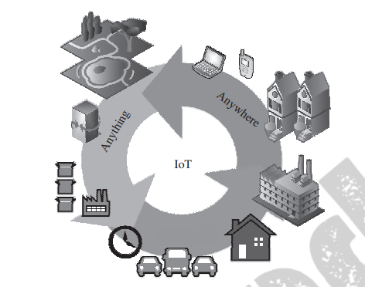
IoT may be considered to be made up of connecting devices, machines, and tools these things are made up of sensors/actuators and processors, which connect to the Internet through wireless technologies
Dept of CSE

Slide 4
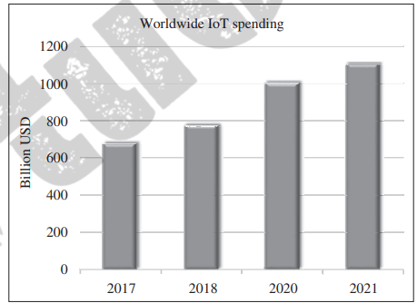
Typically, IoT systems can be characterized by the following features :
• Associated architectures, which are also efficient and scalable.
• No ambiguity in naming and addressing.
• Massive number of constrained devices, sleeping nodes, mobile devices, and non-IP devices.
• Intermittent and often unstable connectivity
Dept of CSE

Slide 5
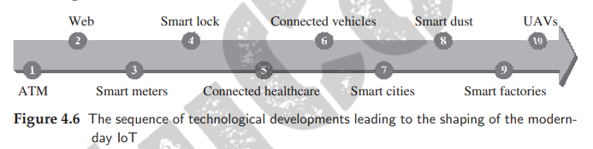
The IoT, as we see it today, is a result of a series of technological paradigm shifts over a few decades.
The technologies that laid the foundation of connected systems by achieving easy integration to daily lives, popular public acceptance, and massive benefits by using connected solutions can be considered as the founding solutions for the development of IoT
Dept of CSE

Slide 6
• ATM: ATMs or automated teller machines are cash distribution machines, which are linked to a user’s bank account. The first ATM became operational and connected online for the first time in 1974.
• Web: World Wide Web is a global information-sharing and communication platform. The Web became operational for the first time in 1991.
• Smart Meters: The earliest smart meter was a power meter, which became operational in early 2000. These power meters were capable of communicating remotely with the power grid. They enabled remote monitoring of subscribers’ power usage and eased the process of billing and power allocation from grids.
Dept of CSE

Slide 7
• Digital Locks: Digital locks can be considered as one of the earlier attempts at connected home automation systems.
• Connected Healthcare: Here, healthcare devices connect to hospitals, doctors, and relatives to alert them of medical emergencies and take preventive measures.
Connected Vehicles: Connected vehicles may communicate to the Internet or with other vehicles, or even with sensors and actuators contained within it. These vehicles self-diagnose themselves and alert owners about system failures
Dept of CSE

Slide 8
.
• Smart Cities: This is a city-wide implementation of smart sensing, monitoring, and actuation systems.
• Smart Dust: These are microscopic computers. Smaller than a grain of sand each, they can be used in numerous beneficial ways, where regular computers cannot operate.
• Smart Factories: These factories can monitor plant processes, assembly lines, distribution lines, and manage factory floors all on their own.
• UAVs: UAVs or unmanned aerial vehicles have emerged as robust public domain solutions tasked with applications ranging from agriculture, surveys, surveillance, deliveries, stock maintenance, asset management, and other tasks.
Dept of CSE

Slide 9
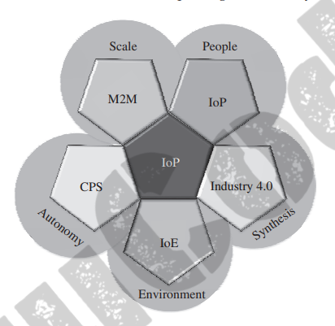
Technological interdependencies of IoT with other domains and networking paradigms
Dept of CSE

Slide 10
M2M: The M2M or the machine-to-machine paradigm signifies a system of connected machines and devices, which can talk amongst themselves without human intervention.
CPS: The CPS or the cyber physical system paradigm insinuates a closed control loop—from sensing, processing, and finally to actuation—using a feedback mechanism.
IoE: The IoE paradigm is mainly concerned with minimizing and even reversing the ill-effects of the permeation of Internet-based technologies on the environment
Dept of CSE

Slide 11
Industry 4.0: Industry 4.0 is commonly referred to as the fourth industrial revolution pertaining to digitization in the manufacturing industry. This paradigm strongly puts forward the concept of smart factories, where machines talk to one another without much human involvement based on a framework of CPS and IoT.
IoP: IoP is a new technological movement on the Internet which aims to decentralize online social interactions, payments, transactions, and other tasks while maintaining confidentiality and privacy of its user’s data
Dept of CSE

Slide 12
Enabling IoT and the Complex Interdependence of Technologies
IoT paradigm into four planes:
services,
local connectivity,
global connectivity
and processing
The service plane is composed of two parts:
1) things or devices and
2) low-power connectivity
Dept of CSE

Slide 13
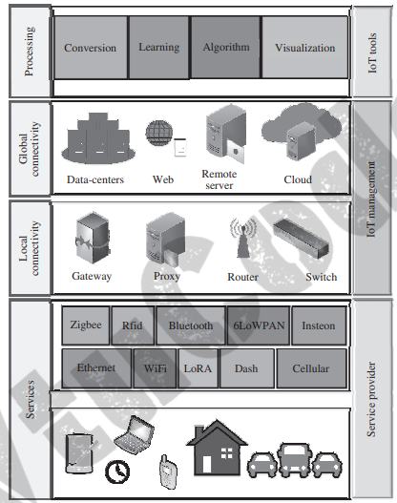
Dept of CSE

Slide 14
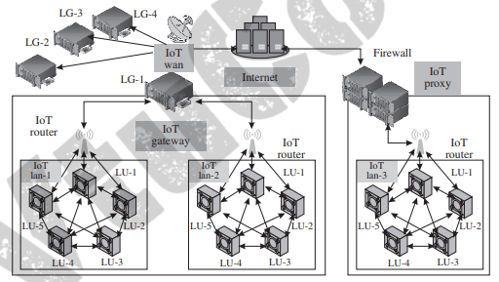
IoT Networking Components
Dept of CSE

Slide 15
IoT Node: These are the networking devices within an IoT LAN. Each of these devices is typically made up of a sensor, a processor, and a radio, which communicates with the network infrastructure (either within the LAN or outside it). The nodes may be connected to other nodes inside a LAN directly or by means of a common gateway for that LAN. Connections outside the LAN are through gateways and proxies.
IoT Router: An I oT router is a piece of networking equipment that is primarily tasked with the routing of packets between various entities in the IoT network; it keeps the traffic flowing correctly within the network. A router can be repurposed as a gateway by enhancing its functionalities.
IoT LAN: The local area network (LAN) enables local connectivity within the purview of a single gateway. Typically, they consist of short-range connectivity technologies. IoT LANs may or may not be connected to the Internet. Generally, they are localized within a building or an organization
Dept of CSE

Slide 16
(iV) IoT WAN: The wide area network (WAN) connects various network segments such as LANs. They are typically organizationally and geographically wide, with their operational range lying between a few kilometers to hundreds of kilometers. IoT WANs connect to the Internet and enable Internet access to the segments they are connecting
(v) IoT Gateway: An IoT gateway is simply a router connecting the IoT LAN to a WAN or the Internet. Gateways can implement several LANs and WANs. Their primary task is to forward packets between LANs and WANs, and the IP layer using only layer 3.
(vi) IoT Proxy: Proxies actively lie on the application layer and performs application layer functions between IoT nodes and other entities. Typically, application layer proxies are a means of providing security to the network entities under it ; it helps to extend the addressing range of its network
Dept of CSE

Slide 17
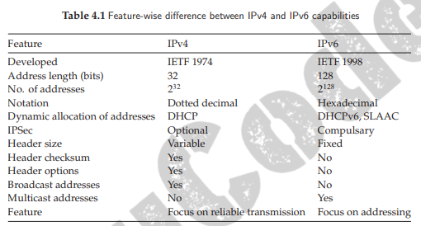
Addressing Strategies in IoT
Dept of CSE

Slide 18
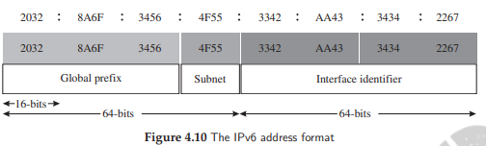
Global Unicast (GUA): These addresses are assigned to single IoT entities/ interfaces; they enable the entities to transmit traffic to and from the Internet. In regular IoT deployments, these addresses are assigned to gateways, proxies, or WANs.
(ii) Multicast: These addresses enable transmission of messages from a single networked entity to multiple destination entities simultaneously.
(iii) Link Local (LL): The operational domain of these addresses are valid only within a network segment such as LAN. These addresses may be repeated in other network segments/LANs, but are unique within that single network segment.
Dept of CSE

Slide 19
(iv) Unique Local (ULA): Similar to LL addresses, ULA cannot be routed over the Internet. These addresses may be repeated in other network segments/LANs, but are unique within that single network segment.
(v) Loopback: It is also known as the localhost address. Typically, these addresses are used by developers and network testers for diagnostics and system checks.
(vi) Unspecified: Here, all the bits in the IPv6 address are set to zero and the destination address is not specified. (vii) Solicited-node Multicast: It is a multicast address based on the IPv6 address of an IoT node or entity
Dept of CSE

Slide 20
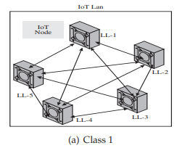
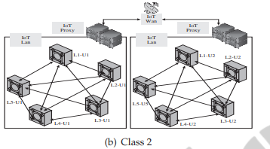
Address management classes
Class 1: The IoT nodes are not connected to any other interface or the Internet except with themselves. This class can be considered as an isolated class, where the communication between IoT nodes is restricted within a LAN only. The IoT nodes in this class are identified only by their link local (LL) addresses
Dept of CSE
Class 2: The class 1 configuration is mainly utilized for enabling communication between two or more IoT LANs or WANs. The IoT nodes within the LANs cannot directly communicate to nodes in the other LANs using their LL addresses, but through their LAN gateways (which have a unique address assigned to them). Generally, ULA is used for addressing; however, in certain scenarios, GUA may also be used

Slide 21
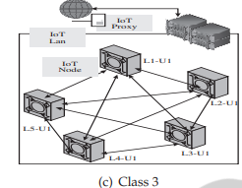
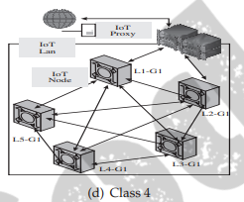
Class 3: shows a class 3 IoT network configuration, where the IoT LAN is connected to an IoT proxy
Class 4: In this class, the IoT proxy acts as a gateway between the LAN and the Internet, and provides GUA to the IoT nodes within the LAN. A globally unique prefix is allotted to this gateway, which it uses with the individual device identifiers to extend global Internet connectivity to the IoT nodes themselves
Dept of CSE

Slide 22
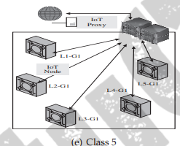
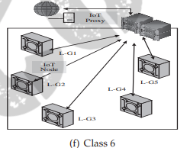
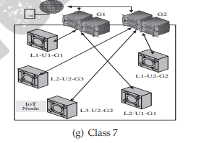
Class 5: This class is functionally similar to class 4. However, the main difference with class 4 is that this class follows a star topology with the gateway as the center of the star. All the communication from the IoT nodes under the gateway has to go through the gateway
Class 6: The configuration of this class is again similar to class 5. However, the IoT nodes are all assigned unique global addresses (GUA), which enables a point-to-point communication network with an Internet gateway
Dept of CSE
Class 7: Multiple gateways may be present; the configuration is such that the nodes should be reachable through any of the gateways. Typically, organizational IoT deployments follow this class of configuration. The concept of multihoming is important and inherent to this class

Slide 23
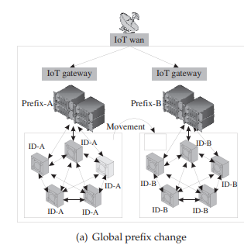
Addressing during node mobility
(i) Global Prefix Changes: abstracts the addressing strategy using global prefix changes. A node from the left LAN moves to the LAN on the right. The node undergoing movement is highlighted in the figure. The nodes in the first LAN have the prefix A, which changes to B under the domain of the new gateway overseeing the operation of nodes in the new LAN
Dept of CSE

Slide 24
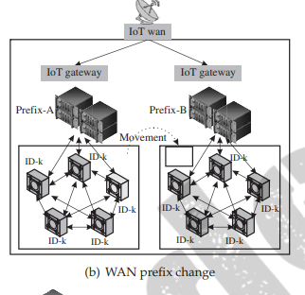
(II)Prefix Changes within WANs: Figure 4.12(b) abstracts the addressing strategy for prefix changes within WANs. In case the WAN changes its global prefix, the network entities underneath it must be resilient to change and function normally. The address allocation is hence delegated to entities such as gateways and proxies, which make use of ULAs to manage the network within the WA
Dept of CSE

Slide 25
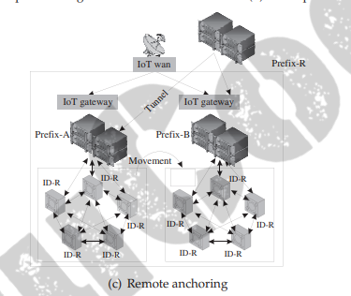
(iii) Remote Anchoring:This is applicable in certain cases which require that the IoT node’s global addresses are maintained and not affected by its mobility or even the change in network prefixes. Even if the node’s original network’s (LAN) prefix changes from A to B, the node’s global address remains immune to this change
Dept of CSE

